Slide 1
Managed Scenario

Slide 2
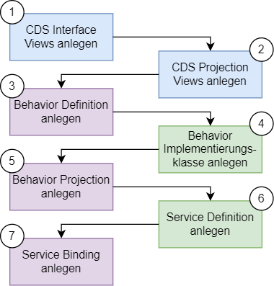
RAP Implementierungs-Workflow

Slide 3



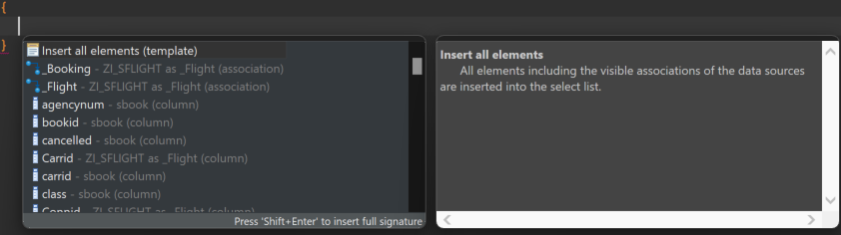

Wurzelentität und Kind Entitäten definieren
Datenquelle angeben
Elemente der Entitäten einfügen
Beziehungen zwischen Wurzel- und Kind Entitäten definieren
Semantische Eigenschaften der Elemente annotieren

Slide 4
@AbapCatalog.viewEnhancementCategory: [#NONE]
@AccessControl.authorizationCheck: #NOT_REQUIRED
@EndUserText.label: 'Interface View SBook'
@Metadata.ignorePropagatedAnnotations: true
@ObjectModel.usageType:{
serviceQuality: #X,
sizeCategory: #S,
dataClass: #MIXED
}
define view entity ZI_SBOOK
as select from sbook
association to parent ZI_SFLIGHT as _Flight on $projection.Carrid = _Flight.Carrid
and $projection.Connid = _Flight.Connid
and $projection.Fldate = _Flight.Fldate
{
key carrid as Carrid,
key connid as Connid,
key fldate as Fldate,
key bookid as Bookid,
customid as Customid,
custtype as Custtype,
smoker as Smoker,
@Semantics.quantity.unitOfMeasure: 'Wunit'
luggweight as Luggweight,
wunit as Wunit,
invoice as Invoice,
class as Class,
@Semantics.amount.currencyCode: 'Forcurkey'
forcuram as Forcuram,
forcurkey as Forcurkey,
@Semantics.amount.currencyCode: 'Loccurkey'
loccuram as Loccuram,
loccurkey as Loccurkey,
order_date as OrderDate,
counter as Counter,
agencynum as Agencynum,
cancelled as Cancelled,
reserved as Reserved,
passname as Passname,
passform as Passform,
passbirth as Passbirth,
_Flight
}
ZI_SFLIGHT
ZI_SBOOK
@AccessControl.authorizationCheck: #NOT_REQUIRED
@EndUserText.label: 'Interface View SFlight'
define root view entity ZI_SFLIGHT
as select from znm_sflight
composition [0..*] of ZI_SBOOK as _Booking
{
key znm_sflight.carrid as Carrid,
key znm_sflight.connid as Connid,
key znm_sflight.fldate as Fldate,
znm_sflight.price as Price,
znm_sflight.currency as Currency,
znm_sflight.planetype as Planetype,
znm_sflight.seatsmax as Seatsmax,
znm_sflight.seatsocc as Seatsocc,
znm_sflight.paymentsum as Paymentsum,
znm_sflight.seatsmax_b as SeatsmaxB,
znm_sflight.seatsocc_b as SeatsoccB,
znm_sflight.seatsmax_f as SeatsmaxF,
znm_sflight.seatsocc_f as SeatsoccF,
znm_sflight.created_at as CreatedAt,
znm_sflight.created_by as CreatedBy,
znm_sflight.last_changed_at as LastChangedAt,
znm_sflight.last_changed_by as LastChangedBy,
znm_sflight.locl_last_changed_at as LocalLastChangedAt,
_Booking
}

Slide 5



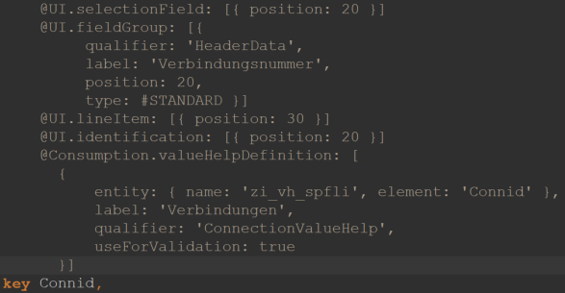
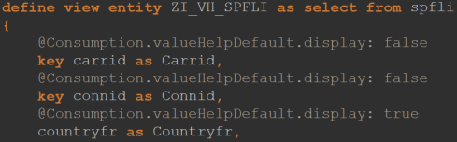
Projection Views anlegen
UI Annotation hinzufügen
lineItem: Anzeige des Elements in Liste
selectionField: Anlegen eines Selektionsfelds des Elements
Identification: Markierung des Elements für Referenz auf Object Page
fieldGroup: Zuweisungd es Elements zu einer Elementgruppe auf der Object Page
Value Help CDS View anlegen und in valueHelpDefinition annotation referenzieren

Slide 6
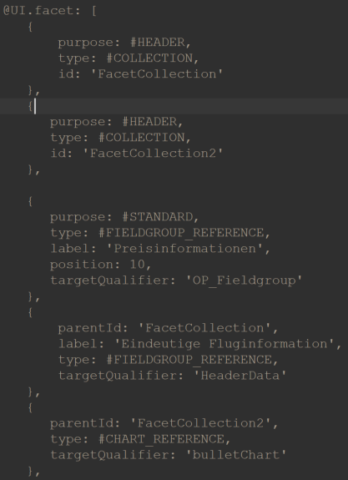
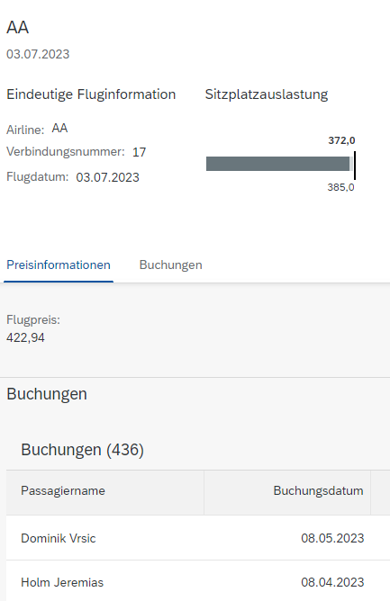
Zu Beginn der Definition werden Facetten für die Object Page definiert
purpose: definiert Zuordnung der Facette zum Header oder zum Standardbereich
type: definiert den Typen der Facette
Verschiedene Facettentypen benötigen unterschiedliche Handhabenung
Beziehungen müssen als Element in die Elementliste aufgenommen werden

Slide 7
ZC_SFLIGHT
@Consumption.valueHelpDefinition: [
{
entity: { name: 'zi_vh_scarr', element: 'Carrid' },
label: 'Fluggesellschaften',
qualifier: 'CarrierValueHelp',
useForValidation: true
}]
@UI: {
lineItem: [
{
position: 10,
importance: #HIGH
}
],
selectionField: [{ position: 10 }],
fieldGroup: [
{
qualifier: 'HeaderData',
position: 10,
label: 'Airline'
}
],
multiLineText: true
}
@UI.identification: [{ position: 10 }]
key Carrid,
@UI.selectionField: [{ position: 20 }]
@UI.fieldGroup: [{
qualifier: 'HeaderData',
label: 'Verbindungsnummer',
position: 20,
type: #STANDARD }]
@UI.lineItem: [{ position: 30 }]
@UI.identification: [{ position: 20 }]
@Consumption.valueHelpDefinition: [
{
entity: { name: 'zi_vh_spfli', element: 'Connid' },
label: 'Verbindungen',
qualifier: 'ConnectionValueHelp',
useForValidation: true
}]
key Connid,
@UI.facet: [
{
purpose: #HEADER,
type: #COLLECTION,
id: 'FacetCollection'
},
{
purpose: #HEADER,
type: #COLLECTION,
id: 'FacetCollection2'
},
{
purpose: #STANDARD,
type: #FIELDGROUP_REFERENCE,
label: 'Preisinformationen',
position: 10,
targetQualifier: 'OP_Fieldgroup'
},
{
parentId: 'FacetCollection',
label: 'Eindeutige Fluginformation',
type: #FIELDGROUP_REFERENCE,
targetQualifier: 'HeaderData'
},
{
parentId: 'FacetCollection2',
type: #CHART_REFERENCE,
targetQualifier: 'bulletChart'
},
{
purpose: #STANDARD,
type: #LINEITEM_REFERENCE,
label: 'Buchungen',
position: 20,
targetElement: '_Booking'
}
]
@EndUserText.label: 'Projection View SFLIGHT'
@AccessControl.authorizationCheck: #NOT_REQUIRED
@UI.headerInfo: {
typeName: 'Flug Root',
typeNamePlural: 'Flüge Root',
title: {
value: 'Carrid',
type: #STANDARD,
label: 'Test'
},
description: {
label: 'Flug Root',
type: #STANDARD,
value: 'Fldate'
}
}
@UI.chart: [
{
qualifier: 'bulletChart',
title: 'Sitzplatzauslastung',
chartType: #BULLET,
measures: [ 'Seatsocc' ],
measureAttributes: [{
measure: 'Seatsocc',
role: #AXIS_1,
asDataPoint: true
}]
}
]
define root view entity ZC_SFLIGHT
provider contract transactional_query
as projection on ZI_SFLIGHT
{

Slide 8
ZC_SFLIGHT
@UI.selectionField: [{ position: 30 }]
@UI.lineItem: [{ position: 40 }]
@UI.fieldGroup: [{
qualifier: 'HeaderData',
label: 'Flugdatum',
position: 30,
type: #STANDARD }]
@UI.identification: [{ position: 30 }]
key Fldate,
@UI.fieldGroup: [{
qualifier: 'OP_Fieldgroup',
position: 10
}]
@UI.identification: [{ position: 40 }]
Price,
Currency,
@UI.lineItem: [{ position: 80 }]
@UI.identification: [{ position: 50 }]
Planetype,
Seatsmax,
@UI: {
dataPoint: {
qualifier: 'Seatsocc',
targetValueElement: 'Seatsmax',
visualization: #PROGRESS,
title: 'Auslastung'
},
lineItem: [
{
type: #AS_DATAPOINT,
label: 'Sitzplatzauslastung Economy',
importance: #HIGH,
position: 50,
valueQualifier: 'Seatsocc'
}
]
}
Seatsocc,
@UI.lineItem: [{ position: 100 }]
Paymentsum,
@Consumption.filter.hidden: true
SeatsmaxB,
@Consumption.filter.hidden: true
@UI.lineItem: [{ position: 100 }]
SeatsoccB,
@Consumption.filter.hidden: true
SeatsmaxF,
@Consumption.filter.hidden: true
@UI.lineItem: [{ position: 100 }]
SeatsoccF,
CreatedAt,
CreatedBy,
LastChangedAt,
LastChangedBy,
LocalLastChangedAt,
/* Associations */
_Booking : redirected to composition child ZC_SBOOK
}

Slide 9
ZC_SBOOK
key Carrid,
key Connid,
key Fldate,
@UI.lineItem: [{ position: 50 }]
@UI.identification: [{ position: 10 }]
key Bookid,
@UI.identification: [{ position: 20 }]
Customid,
@UI.identification: [{ position: 30 }]
Custtype,
@UI.identification: [{ position: 40 }]
Smoker,
@UI.lineItem: [{ position: 30 }]
@UI.identification: [{ position: 50,
type: #FOR_ACTION,
dataAction: 'upgrade_class',
label: 'Upgrade' }]
Luggweight,
Wunit,
Invoice,
@UI.lineItem: [{ position: 40 }]
@UI.identification: [{ position: 51 }]
Class,
Forcuram,
Forcurkey,
Loccuram,
Loccurkey,
@UI.lineItem: [{ position: 20 }]
@UI.identification: [{ position: 60 }]
OrderDate,
Counter,
Agencynum,
Cancelled,
@UI.identification: [{ position: 70 }]
Reserved,
@UI.lineItem: [{ position: 10 }]
Passname,
Passform,
Passbirth,
/* Associations */
_Flight: redirected to parent ZC_SFLIGHT
}
@EndUserText.label: 'Projection View SBOOK'
@AccessControl.authorizationCheck: #NOT_REQUIRED
@UI.headerInfo: {
typeName: 'Buchung',
typeNamePlural: 'Buchungen',
title: {
value: 'Passname',
type: #STANDARD,
label: 'Name'
},
description: {
label: 'Buchungsnummer',
type: #STANDARD,
value: 'Bookid'
}
}
define view entity ZC_SBOOK
as projection on ZI_SBOOK
{
@UI.facet: [{ purpose: #STANDARD,
position: 10,
label: 'Buchungsinformationen',
type: #IDENTIFICATION_REFERENCE }]

Slide 10
ZI_VH_SCARR
ZI_VH_SPFLI
@AbapCatalog.viewEnhancementCategory: [#NONE]
@AccessControl.authorizationCheck: #NOT_REQUIRED
@EndUserText.label: 'Value Help Carrier'
@Metadata.ignorePropagatedAnnotations: true
@ObjectModel.usageType:{
serviceQuality: #X,
sizeCategory: #S,
dataClass: #MIXED
}
define view entity ZI_VH_SCARR as select from scarr
{
@Consumption.valueHelpDefault.display: false
key carrid as Carrid,
@Consumption.valueHelpDefault.display: true
carrname as Carrname,
@Consumption.valueHelpDefault.display: true
currcode as Currcode,
@Consumption.valueHelpDefault.display: true
url as Url
}
@AbapCatalog.viewEnhancementCategory: [#NONE]
@AccessControl.authorizationCheck: #NOT_REQUIRED
@EndUserText.label: 'Value Help Connection'
@Metadata.ignorePropagatedAnnotations: true
@ObjectModel.usageType:{
serviceQuality: #X,
sizeCategory: #S,
dataClass: #MIXED
}
define view entity ZI_VH_SPFLI as select from spfli
{
@Consumption.valueHelpDefault.display: false
key carrid as Carrid,
@Consumption.valueHelpDefault.display: false
key connid as Connid,
@Consumption.valueHelpDefault.display: true
countryfr as Countryfr,
@Consumption.valueHelpDefault.display: true
cityfrom as Cityfrom,
@Consumption.valueHelpDefault.display: true
countryto as Countryto,
@Consumption.valueHelpDefault.display: true
cityto as Cityto
}

Slide 11


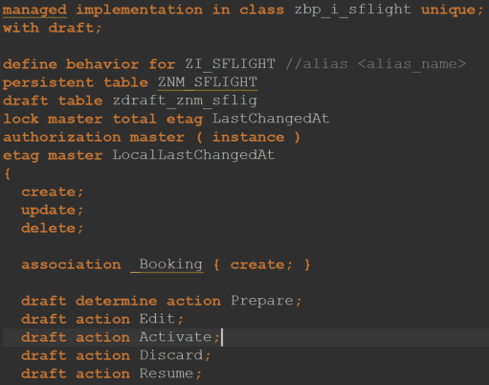
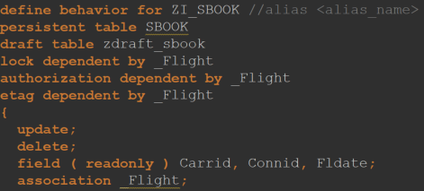
Behavior Definition für Wurzel Entität und Kind Entitäten in einem Entwicklungsobjekt anlegen
Namen für Implementierungsklasse angeben und über die Hilfe automatisch anlegen lassen
Namen für die persistente und draft Tabellen können angegeben und mit der Hilfe automatisch angelegt werden
Sperr- und Authorisierungsverhalten definieren
CRUD Operationen angeben, die für die Geschäftsobjekte möglich sein sollen
Bei der Verwendung von Draft sind die Actions Prepare, Edit, Activate, Discard und Resume verpflichtend anzugeben

Slide 12
ZI_SFLIGHT
managed implementation in class zbp_i_sflight unique;
with draft;
define behavior for ZI_SFLIGHT //alias <alias_name>
persistent table ZNM_SFLIGHT
draft table zdraft_znm_sflig
lock master total etag LastChangedAt
authorization master ( instance )
etag master LocalLastChangedAt
{
create;
update;
delete;
association _Booking { create; }
draft determine action Prepare;
draft action Edit;
draft action Activate;
draft action Discard;
draft action Resume;
validation validateFlightDate on save {create;}
}
define behavior for ZI_SBOOK //alias <alias_name>
persistent table SBOOK
draft table zdraft_sbook
lock dependent by _Flight
authorization dependent by _Flight
etag dependent by _Flight
{
update;
delete;
field ( readonly ) Carrid, Connid, Fldate;
association _Flight;
action ( features : instance ) upgrade_class result [1] $self;
determination checkSeatsOcc on modify {create;}
}

Slide 13

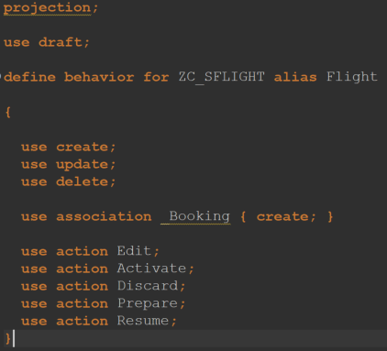
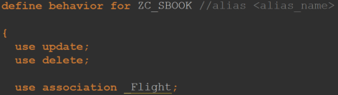
Projektionen der Behavior Definitions anlegen
CRUD Operationen angeben
Zuvor definierte Actions angeben

Slide 14
ZC_SFLIGHT
projection;
use draft;
define behavior for ZC_SFLIGHT alias Flight
{
use create;
use update;
use delete;
use association _Booking { create; }
use action Edit;
use action Activate;
use action Discard;
use action Prepare;
use action Resume;
}
define behavior for ZC_SBOOK //alias <alias_name>
{
use update;
use delete;
use association _Flight;
use action upgrade_class;
}

Slide 15



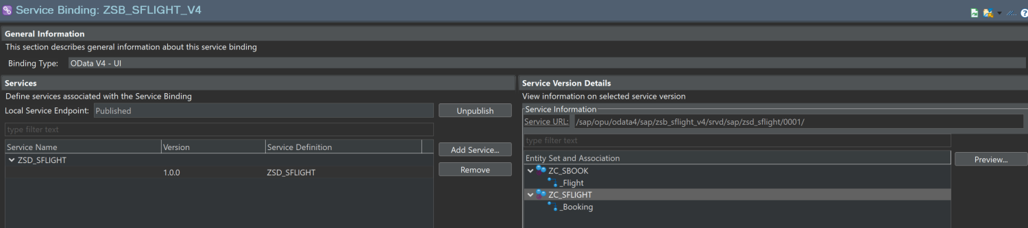
Service Definition und Binding (ODATA V4) anlegen
In Transaktion /n/iwfnd/v4_admin Service veröffentlichen
In Service Binding auf ZC_SFLIGHT und dann auf Preview klicken

Slide 16
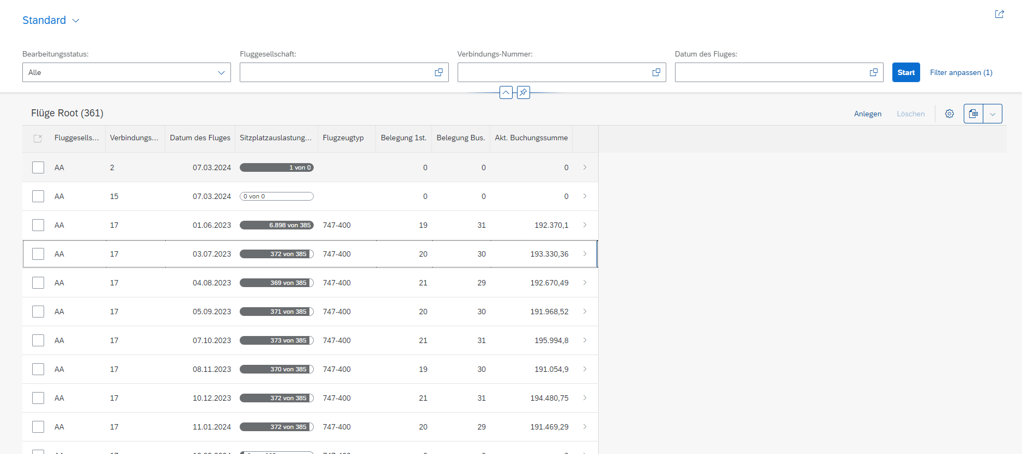

Slide 17
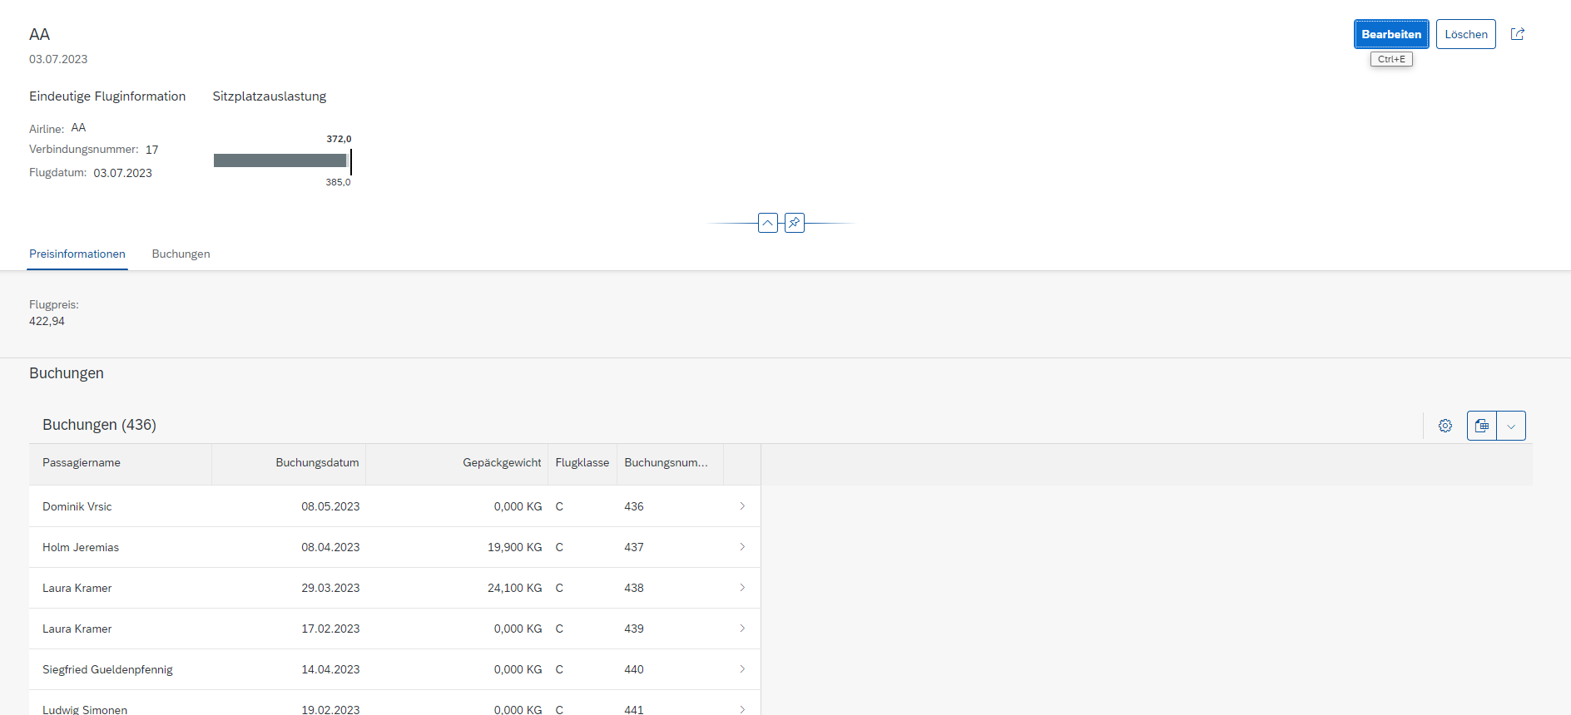

Slide 18
Transaktionales Verhalten

Slide 19

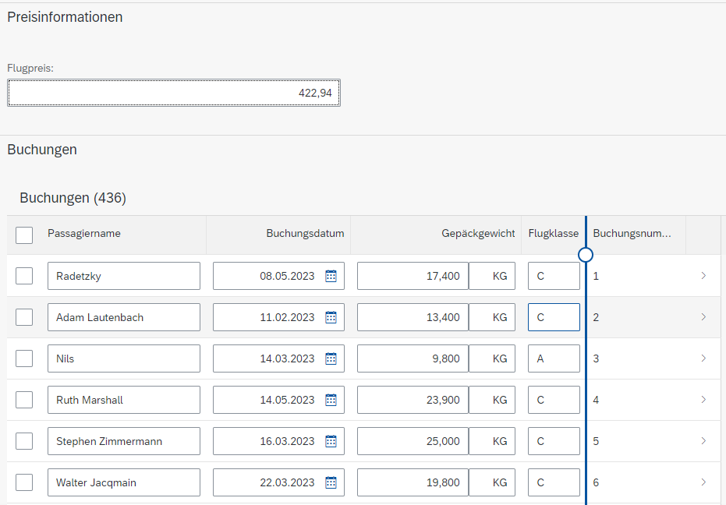
CRUD Operationen
Die Standardoperationen Create, Read, Update, Delete werden im RAP Managed Scenario vom BO-Provider zur Verfügung gestellt und müssen nicht manuell implementiert werden
Die entsprechenden Buttons erscheinen in der UI, sobald die entsprechenden Definitionen in den Behavior Definitions vorgenommen wurden

Slide 20


Actions
Die Action in Behavior Definition angeben
Die Action in Projektion der Behavior Definition angeben
Die Action als UI Annotation an entsprechender Stelle angeben

Slide 21
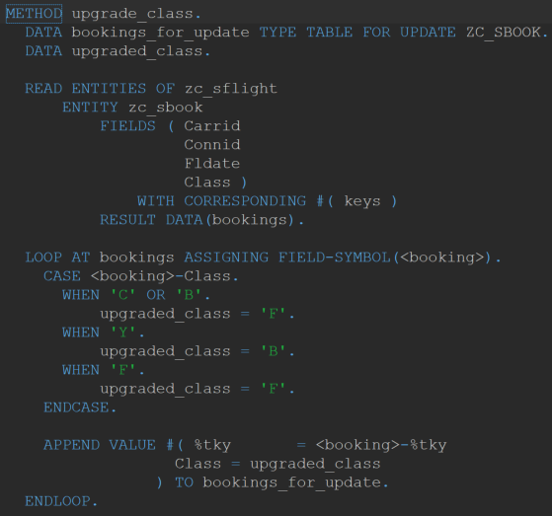
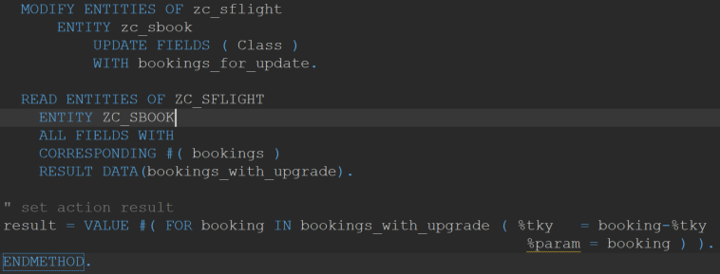
Action mittels EML implementieren

Slide 22
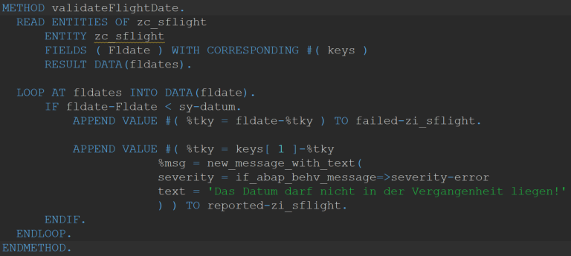
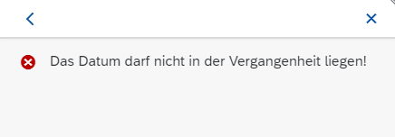
Validations
Validation in Behavior Definition inklusive Trigger angeben
Validation in Verhaltensimplementierungsklasse implementieren
Fehlernachricht definieren

Slide 23
Determinations
Determination ähnlich zur Validation in Behavior Definition angeben
Zusatzaufgabe: Determination in Verhaltensimplementierungsklasse implementieren
Nach dem Anlegen einer neuen Buchung, soll die Sitzplatzbelegung aktualisiert werden

Slide 24
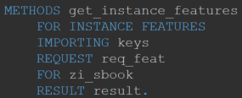
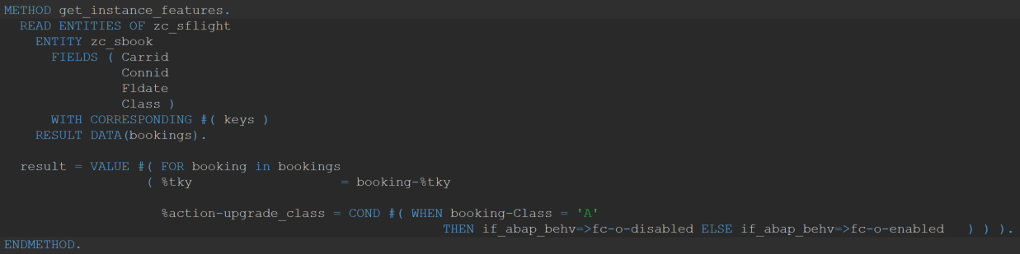
Dynamic Feature Control
Action kann durch Angabe der Klammer unter bestimmten Umständen ausgeblendet werden

Slide 25
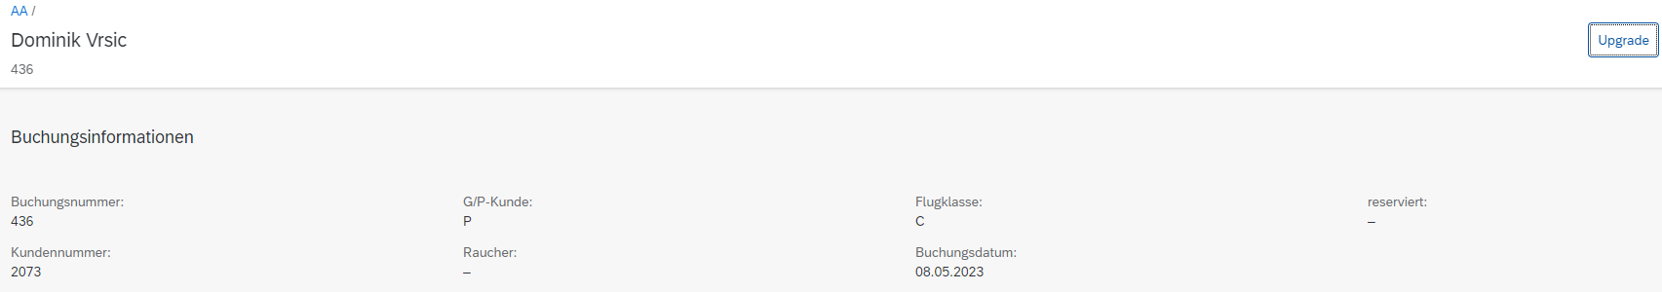
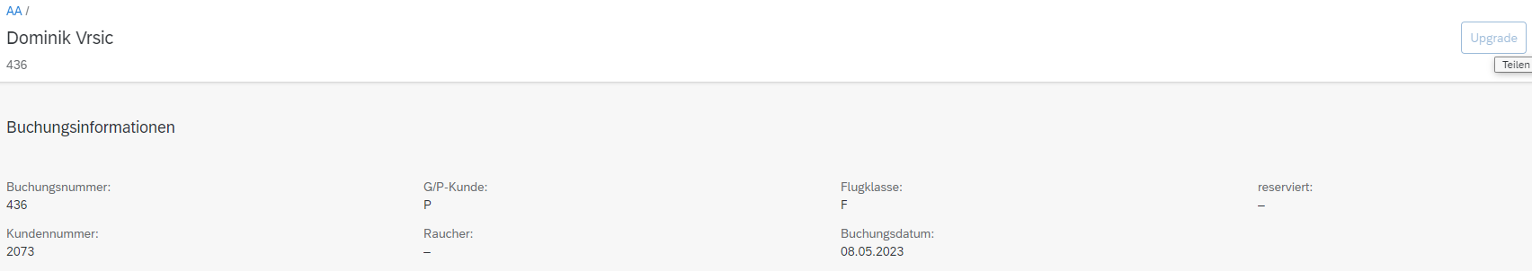
Dynamic Feature Control
Hat der Kunde die höchste Stufe, ist der Upgrade Button ausgegraut

Slide 26
Metadata

Slide 27
Hands on - Gemeinsam
Erstelle eine Metadata Extension.

Slide 28
Quiz
Nenne die Schritte des Implementierungsworkflows.
Wozu dient die Metadata Extension?
Wenn ich eine eigene Action hinzufüge, was gilt es zu beachten?
Welches transaktionale Verhalten haben wir implementiert?
Was meinst du, warum die Behavior Implementierung im lokalen und nicht globalen Teil der Klasse zu finden ist?

Slide 29
Zusatz: Side Effects
Diese sind nur im Strict( 2 ) Modus möglich. Dafür ist das Schulungssystem nicht ausgelegt.

